Slide 1
_{The Inheritors}
Present
_{WIGGADO-BREAK}

Slide 2
_{The Inheritors}
Present
_{Members:}
1. Mohammad Rakibul Islam - C243152
_{2. Shahrier Mahmud - C243027}
_{3. Md. Samidul Islam - C243008}
4. Muhammad Rahatul Islam - C243007

Slide 3
FUNCTIONALITIES
In this project, we are going to develop a game with C++ using OOP and the SFML framework. The goal of the game is as follows:
1. There will be some elements: ball, paddle, brick.
2. The ball will be deflected from the paddle, and whenever it hits a brick (placed in the sky), it will break the brick and also be deflected.
3. The game will have multiple levels, each one more difficult than the previous one.
4. We’ll try to add extra features like power-ups in this game.

Slide 4
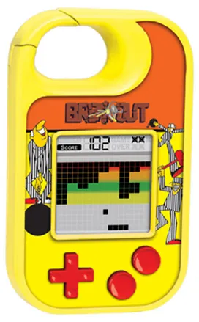
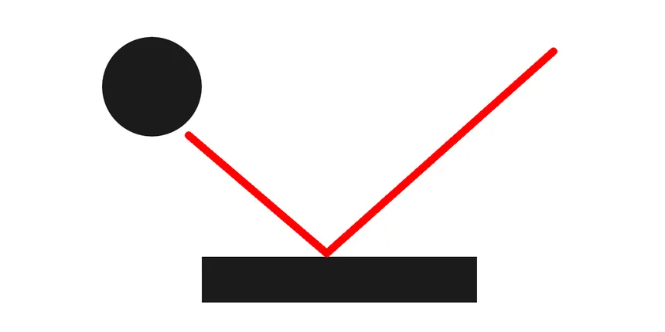
This game will likely to bring your childhood memories back!
These are the ball and the paddle

Slide 5
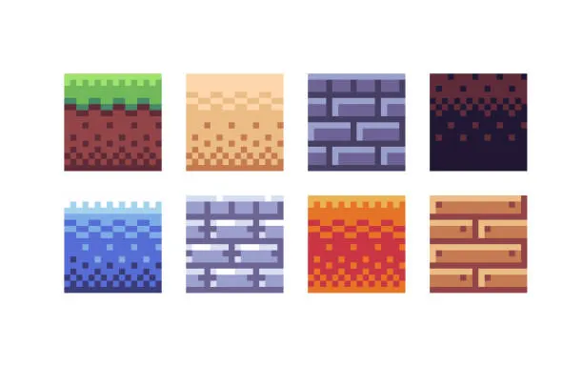
These pictures are gonna be the brick that we’ll use (Probably)

Slide 6
THANK YOU

